Slide 1
Project “Daniel”
Data Analysis
SingMass 01 March 2023

Slide 2
Species with significant differences between any of the groups

Slide 3
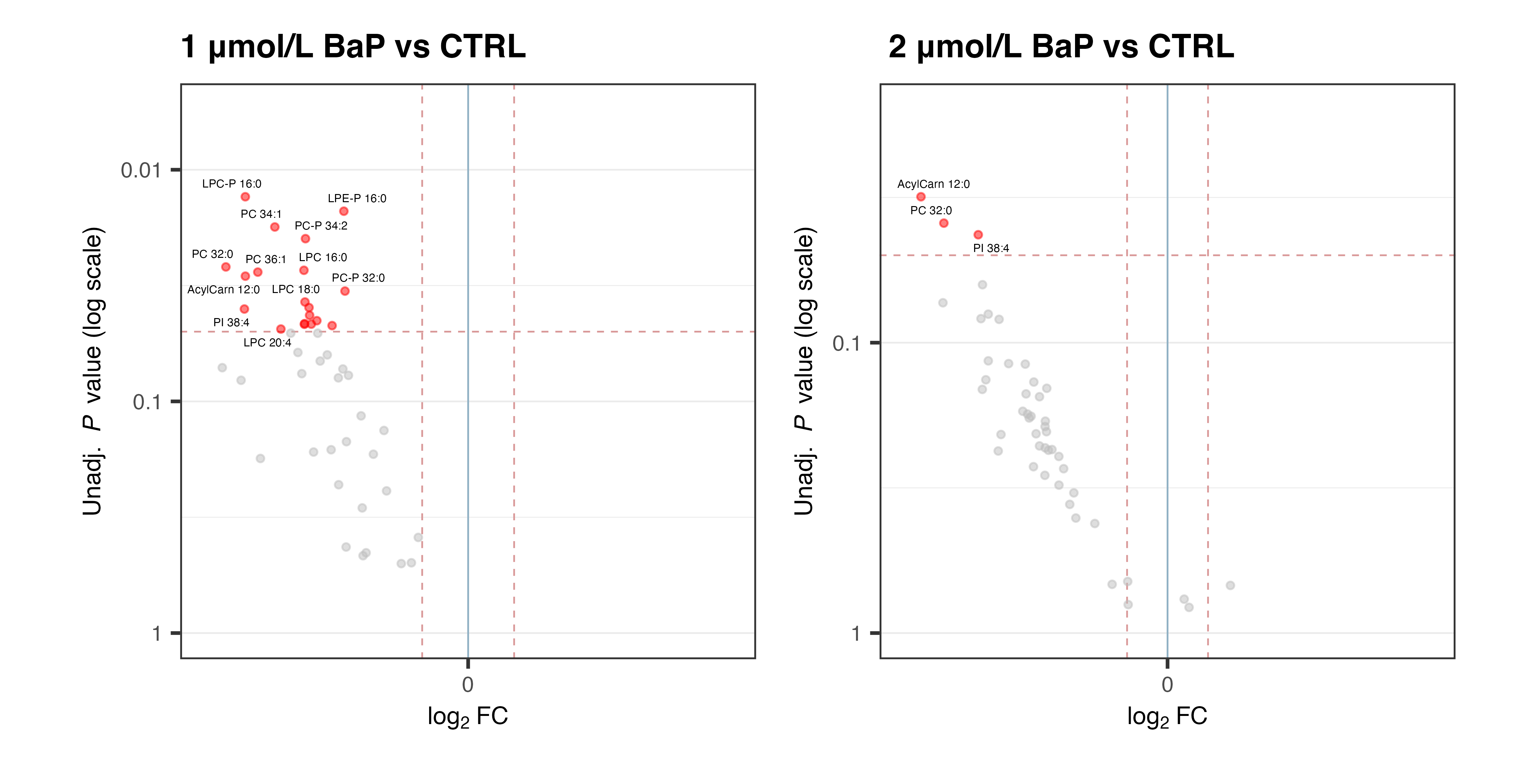
Statistical tests

Slide 4
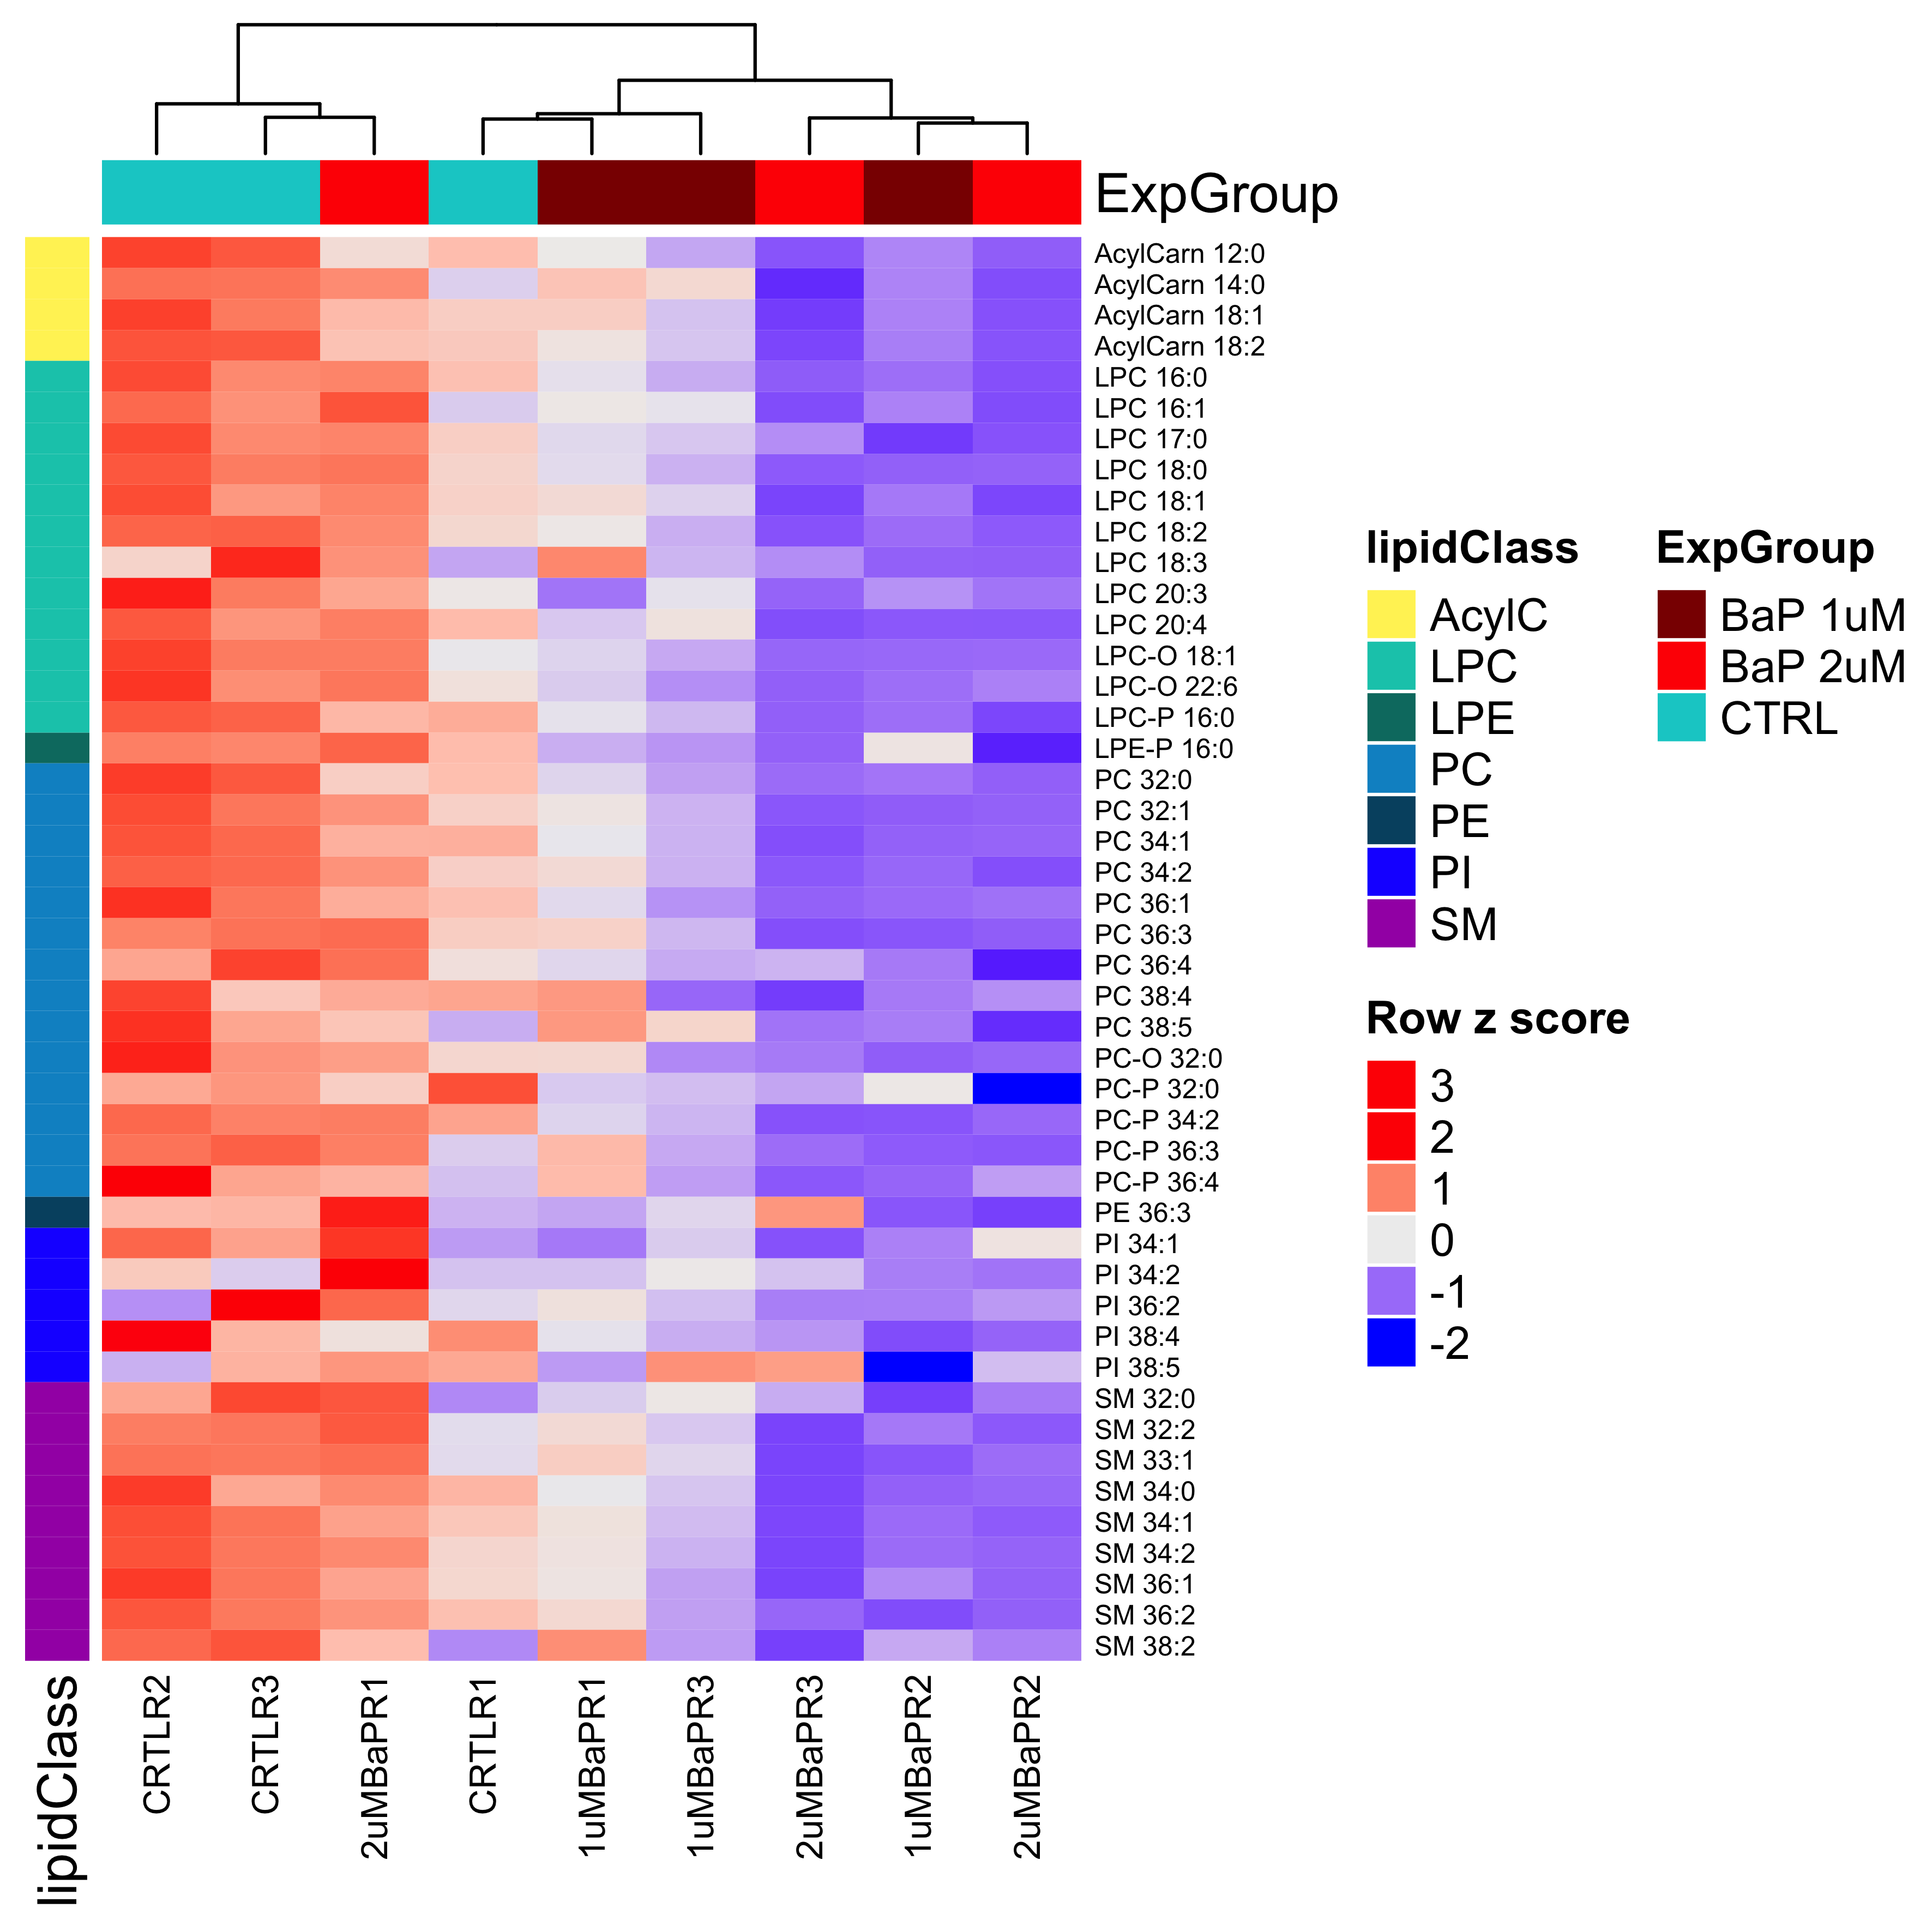
Clustering

Slide 5
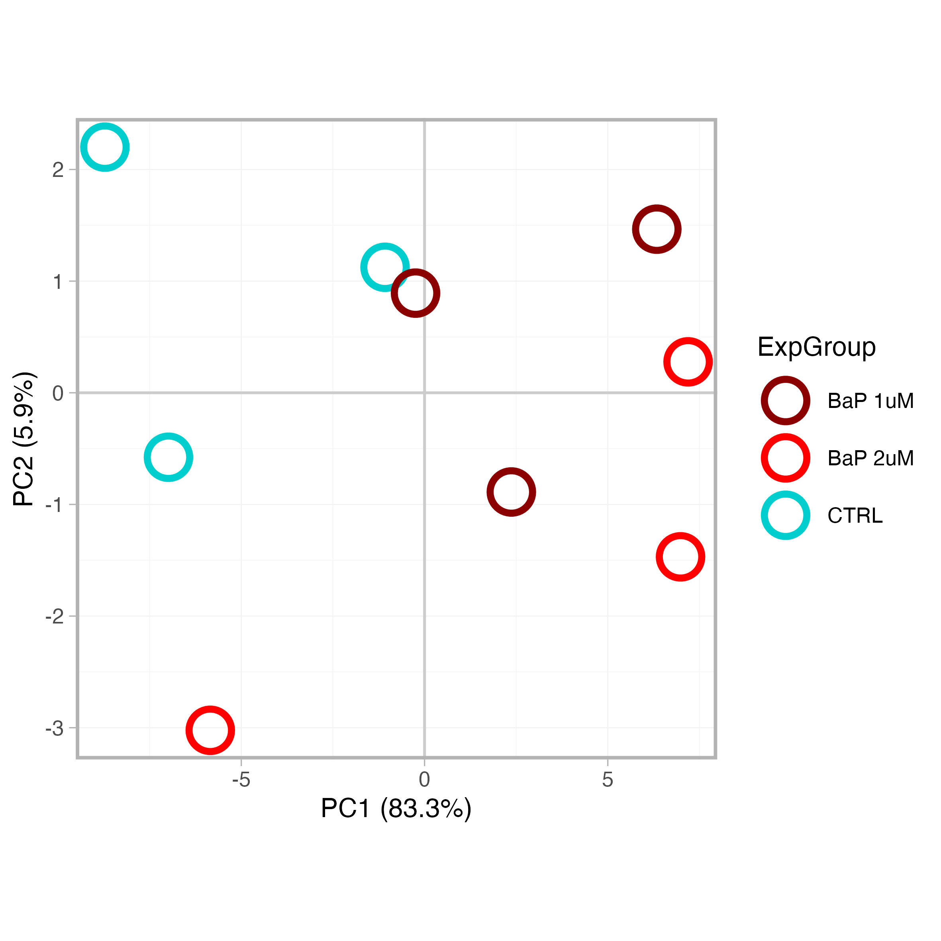
PCA

